Slide 1
HUMAN VALUES, ETHICS AND LIFE SKILLS
RAM LAL ANAND COLLEGE, UNIVERSITY OF DELHI

Slide 2
OFFICE BEARERS
PRATHAM BHATT PRESIDENT
CHESHTA ADLAKHA VICE-PRESIDENT
SANTUSHTI GANDHI
SECRETARY
Dr Rita Jain
Course Coordinator
Dr Sanjay Kumar Sharma
Course Co-Coordinator
Dr Pooja Bansal
Member

Slide 3
Inaugural Session
This year our session was inaugurated by well-known social worker, founder of Ladli foundations, Dr Devendra Kumar Gupta on 5th December, 2020.
He shared his life experiences with students about how he was born with no means but with a positive attitude and humanitarian values that made him possible to become a successful leader.
His talk motivated students so much that many joined his NGO to work for underprivileged.
Also Mr. Devendra Gupta guided the students about core values of being human. The values which are considered basic inherent values in humans include truth, honesty, loyalty, love, peace, etc.
Session was attended 245 students with 183 female students.

Slide 4
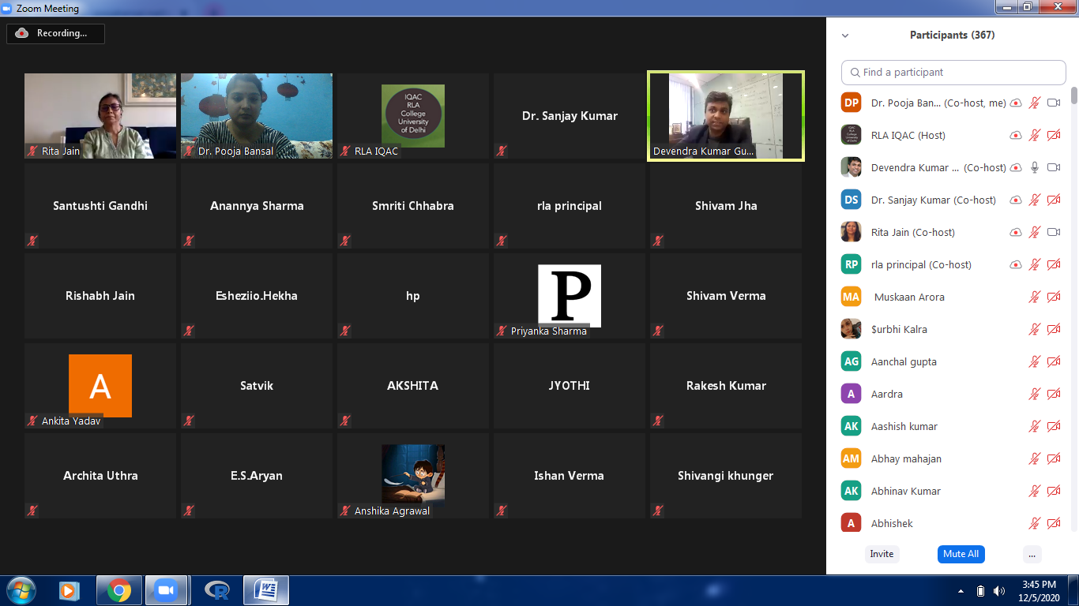
Highlights of the Session

Slide 5
Session On Self Awareness and Self Esteem
The session was organised on four different dates i.e., 7th, 9th, 10th and 11th of December 2021 for GROUPS 1,2,3 and 4 respectively.
The Session was led by MR. GOVIND MISHRA, who is Business Consultant, success Coach and Public speaker and is also a co-founder of ‘Leaders Avenue’.
The aim of the session was to deliver the actual meaning of SELF AWARENESS i.e. Self-awareness is the ability to focus on yourself and how your actions, thoughts, or emotions do or don't align with your internal standards.
Through videos and activities, he made students’ conscious of their own character, nature, feelings, as well as strengths and weaknesses.
The Session was impactful and successful, leaving a positive message.
In all 426(194) students attended his sessions from different streams.

Slide 6
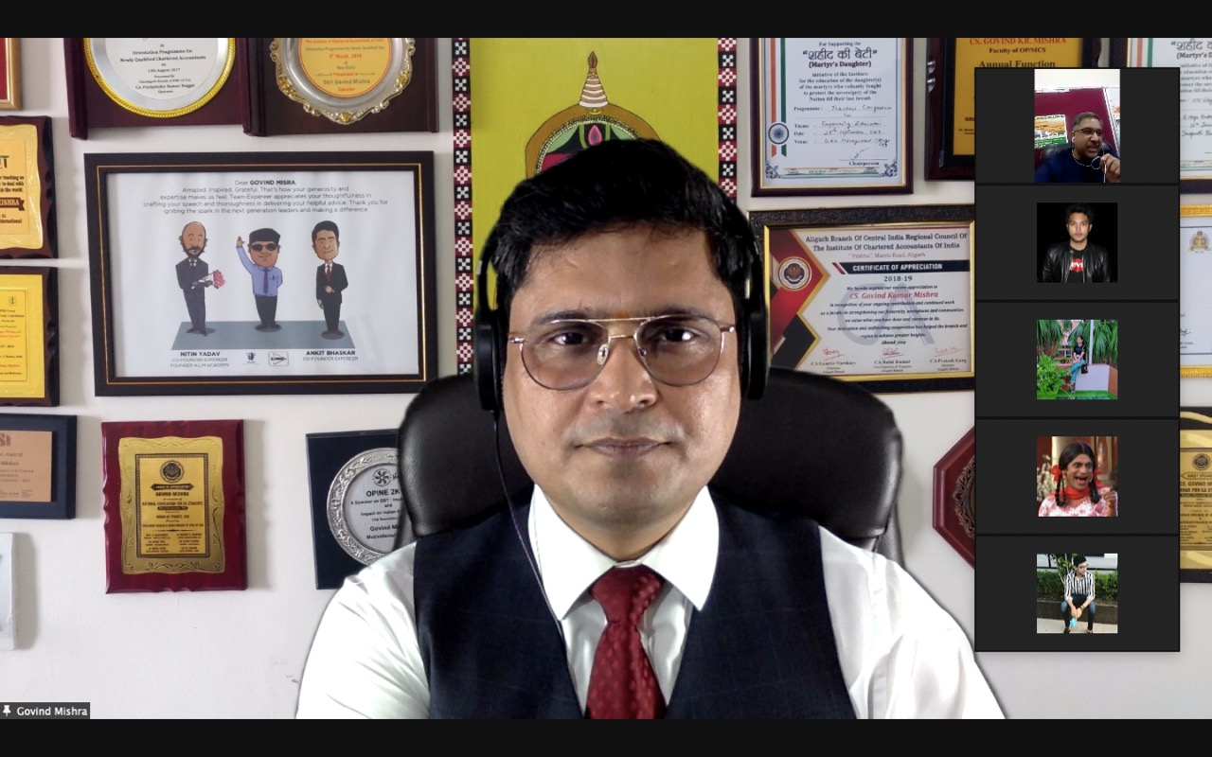
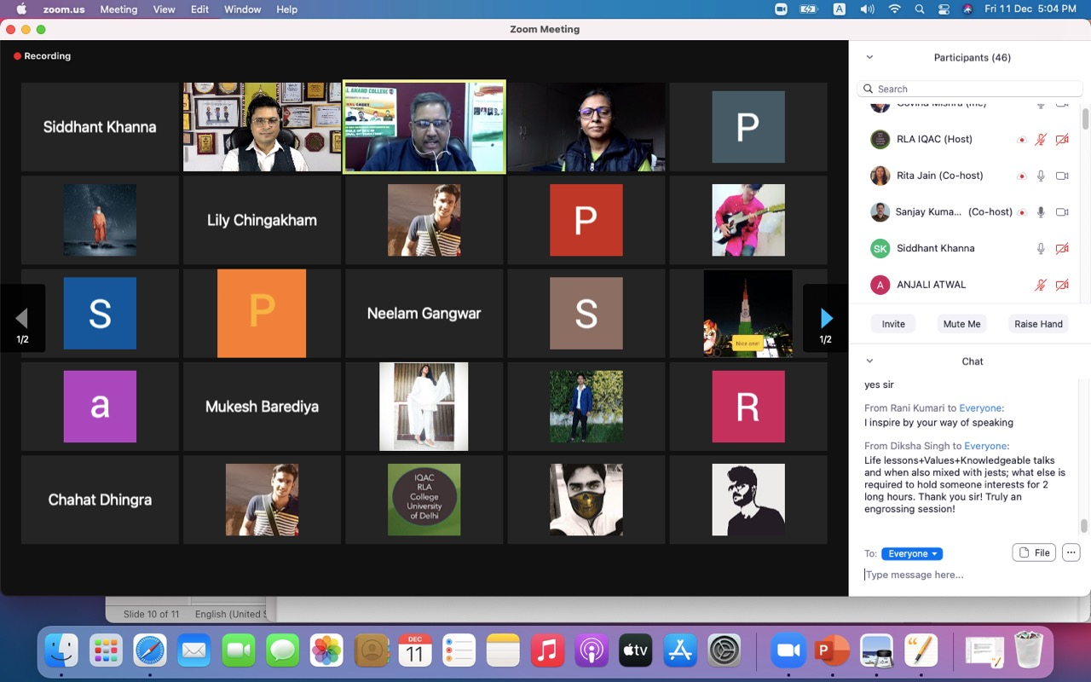
Highlights of the Session

Slide 7
Session On Mental Health & Happitude
The session was organised on 19th of December 2020 for
the 1st Year Students of all the Departments.
MS. MAHAK VAISH, Corporate Trainer and Motivational Speaker, took the session on Mental health and Happy Attitude.
She also discussed about Mental health including our emotional, psychological, and social well-being. It affects how we think, feel, and act as we cope with life.
The session was very interactive as various activities were organised to keep the students active during the session.
She did many activities to make students aware that each individual thinks, behaves and acts in a different manner.
Also, the students were given the chance to share their POINT OF VIEWS and ask their doubts.
Session was attended by 427 with 178 female participants.

Slide 8
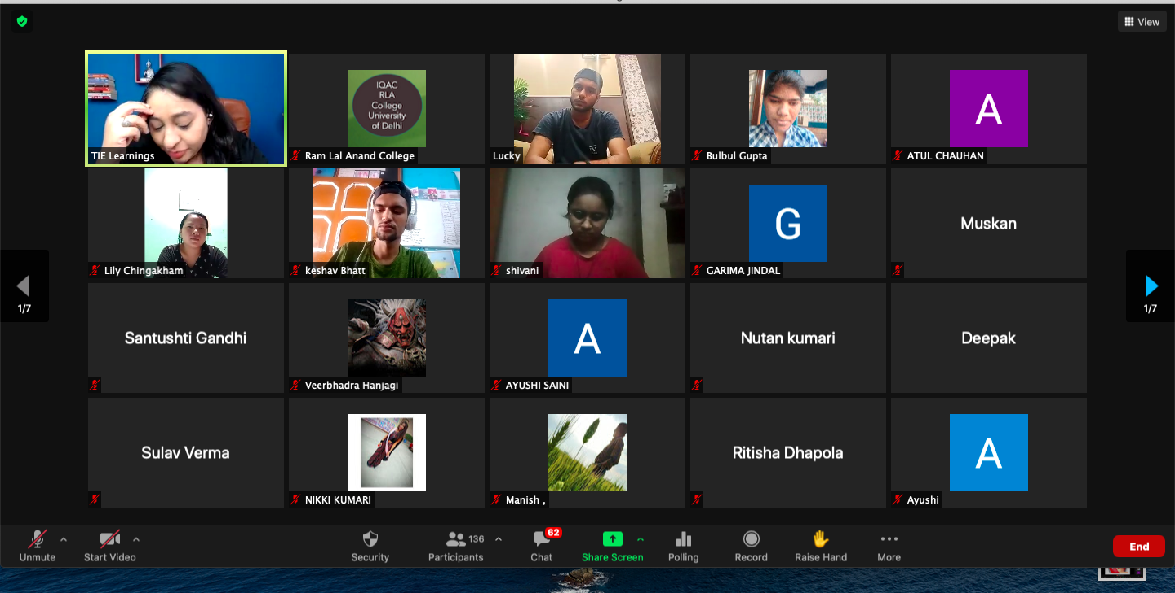
Highlights of the Session

Slide 9
Session On Substance Abuse– Awareness And Prevention
SUBSTANCE ABUSE – AWARENESS AND PREVENTION was the main TOPIC and HIGHLIGHT of the session organised on 2nd of January 2021.
MR. RAJIV SHAW, a consultant and Project Director of many projects for de addiction drives in slum areas, was the speaker for the session.
A discussion about Excessive use of psychoactive drugs, such as alcohol, pain medications or illegal drugs was also inititated. It can lead to physical, social or emotional harm.
Proper awareness about the use and misuse of particular
substances was explained.
Doubts of students regarding the topic of the session were cleared by MR. Rajiv Shaw .
Accurate information of PRECAUTIONS AND PREVENTIONS about and from Harmful Substances was shared with students to increase their awareness.
Session was attended by 427 students with 151 females

Slide 10
Highlights of the Session

Slide 11
Session On Tolerance And Equality
The session was organised on four different dates i.e., 11th, 13th, 14th and 15th of January 2021 for GROUPS 1,2,3 and 4 respectively.
DR. RITA MISHRA, an educationist and founder of NGO ‘Patang’ took a session on ‘Tolerance and Equality’ .
DR. RITA MISHRA also discussed about capacity to endure pain or hardship : endurance, fortitude, stamina.
She showed many short movies and did many activities with students to sensitize them toward gender inequality.
Some healthy DEBATES also took place during the session which made it more interesting.
480(256) students attended her session.

Slide 12
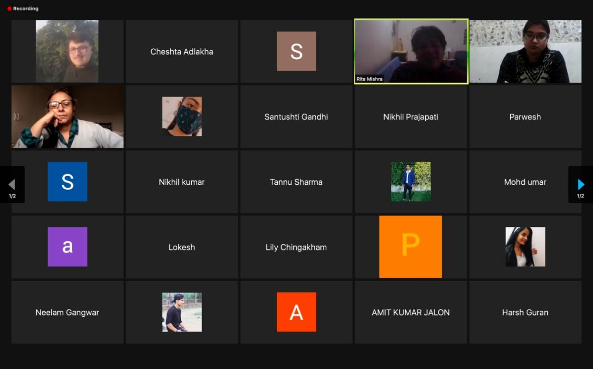
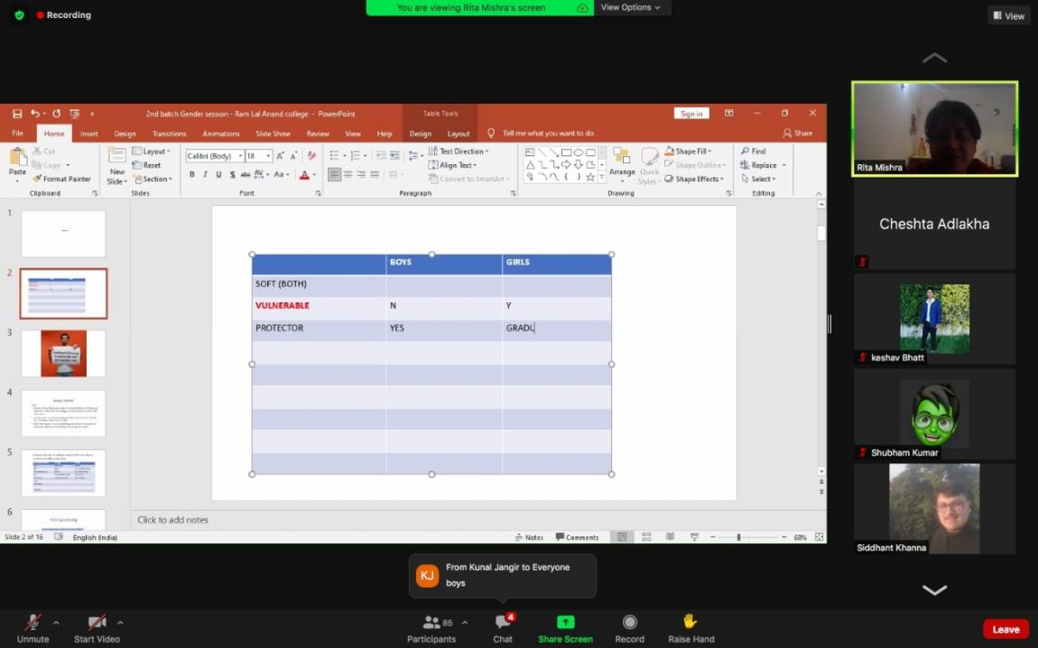
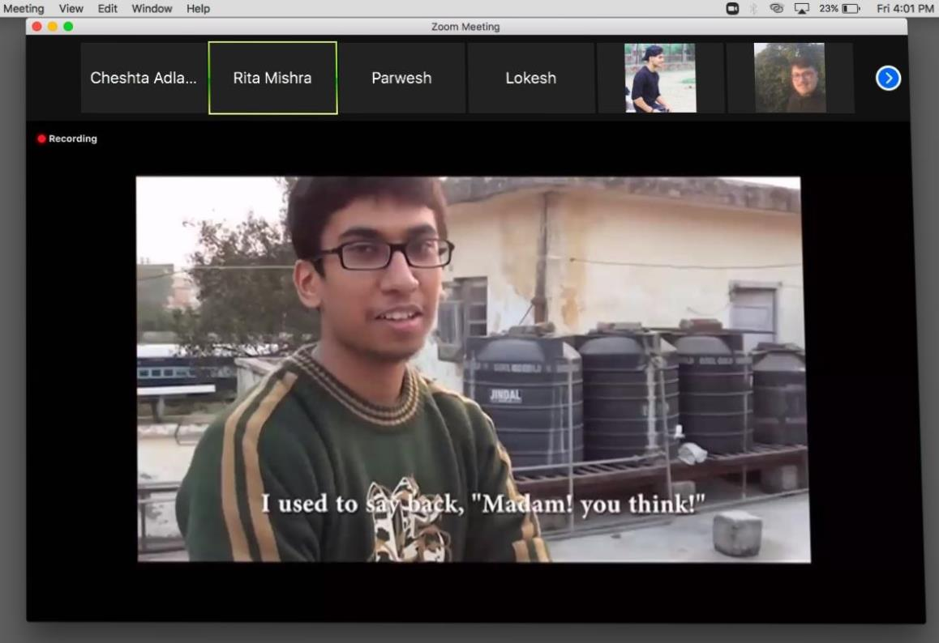
Highlights of the Session

Slide 13
Session On Story Telling
On 23rd of January 2021, a STORY TELLING SESSION was arranged for the students .
MS. INDU PUNJ, founder of Stories Matter, led the session.
The aim of the session was to keep the students fresh and pass on some informative information in an interesting way.
Some fascinating and knowledgeable stories filled the whole session.
In order to show their interest, students from different departments also took a step forward by sharing some of their experiences with others.
A huge number of 518 students with 187 females attended her session

Slide 14
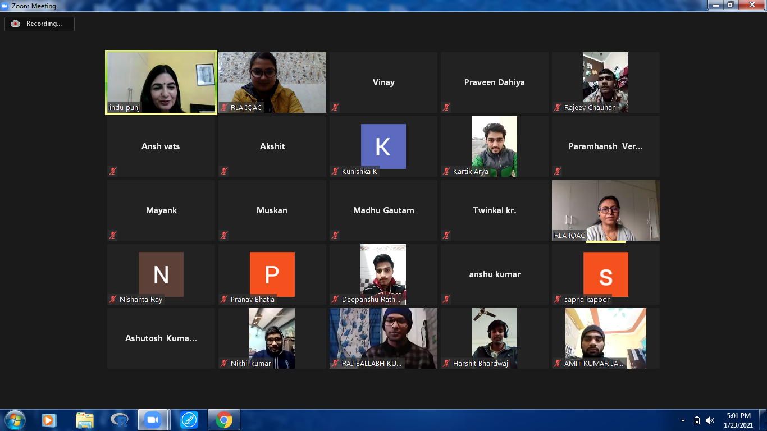
Highlights of the Session

Slide 15
Session On Ethics And Values
On 6th of February 2021 a session on ETHICS AND VALUES was organized.
The Session was led by DR. SWAGATA KARMAKAR who is Faculty from Our College
The session was successful in leaving a great positive impact on the mindset of different students.
Dr. Swagata spoke of variations in ETHICS that are common in the world, and each uniquely practices human values differently.
Session was attended by 391(157) students in all

Slide 16
Session On Critical Thinking & Creative Thinking
On four separate days, i.e. 8th , 10th , 11th and 12th February 2021 for Groups 1,2,3 and 4 respectively, a session on CRITICAL & CREATIVE THINKING was conducted.
MRS. MEENU BHARGAVA, a Senior Trainer from Karan Consultants discussed about the ability to consider something from different prospective.
The session was very engaging as all of the 4 days were full of diverse events and thoughtful procedures.
Activities like PENCIL MESSAGE and IMAGE Recognition were included.
The session had a great positive influence on the student's mind and thinking process.
Her well organized sessions were attended by 401 students having 189 women.

Slide 17
Highlights of the Session

Slide 18
Session On Relationship Towards family & Society
On 20th of February and 6th March 2021 a session was conducted by SUNEEL KESWANI, a Senior Trainer.
The session was well organised and focused on family relationships and ways to improve yourself.
The session started with certain questions which made children to self introspect themselves.
Nevertheless family is all about working things out together than to shoulder everything on yourself.
Session was attended by 450 (302) students.

Slide 19
Highlights of the Session

Slide 20
Workshop – Mr Ashok Arora
Mr Ashok Arora is senior Lawyer and a well known Motivational Speaker.
Through many examples and quotes, he emphasize failures are nothing but a step toward learnings. It teaches you about your strength and weakness and motivates you to rise again.
It leads to the path of correction and self-awareness
As many as 461 with 257 female students attended the session.

Slide 21
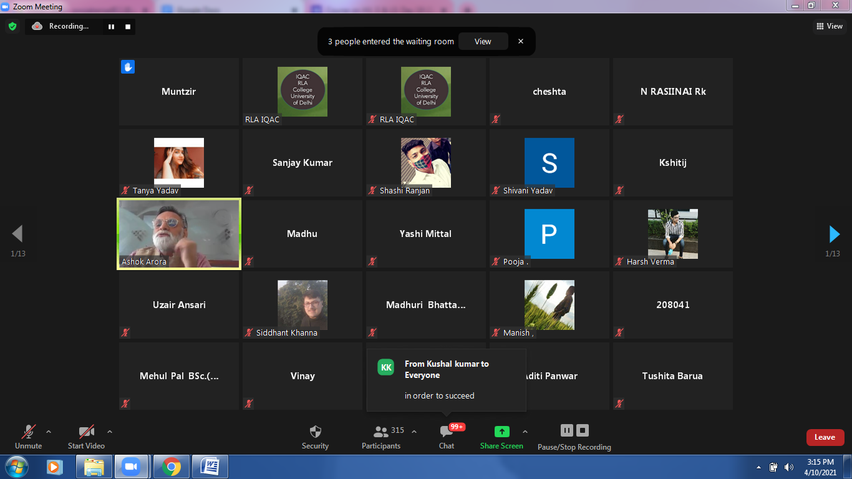
Glimpse of Workshop – Mr Ashok Arora

Slide 22
Workshop – Dr Ajay Kumar Sharma
Dr Ajay Kumar Sharma, an academician and a trainer handled the topic Freedom and Responsibility for different groups on 14, 15 and 16 April, 2021.
Over 417 (174) students attended the session.
With freedom comes responsibility, therefore we must abide by the laws of the state.
He emphasised on self-disciple and respect the freedom of other individuals.
Also follow civic-mindedness and readiness to volunteer
He played many interactive mind games to make student understand the concept.

Slide 23
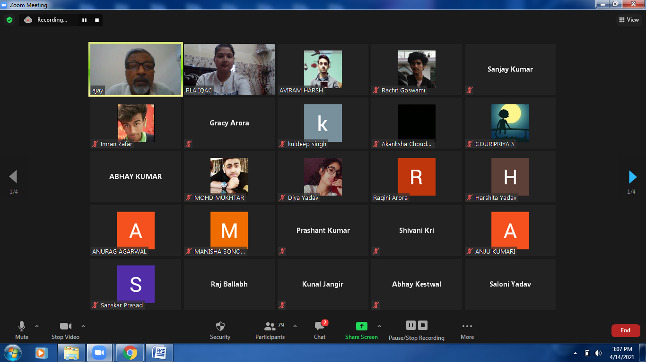
Glimpse of Workshop – Dr Ajay Kumar Sharma

Slide 24
Workshop – Ms Anuja Roy
Ms. Anuja Roy, our next speaker who has an experience of over 17 years as an accomplished professional
She has an expertise in delivering management education, training, communication and relationship management spanning across business development, operations and client interactions.
The session was about to help students learn the significance of personal grooming and an integral role that good ethics play in one’s professional success via various tips and tricks to carry out smart conversations with various individuals, to portray a confident attitude and professional dressing etiquettes.
426 students with 207 females participated in her session.

Slide 25
Glimpse of Workshop – Ms Anuja Roy

Slide 26
Workshop – Mr Rahul Kapoor
Mr. Rahul Kapoor, a Senior Skill Trainer took a session on very important and healthy topic ‘Emotional Intelligence’.
The session focused on how to control and manage your emotions so that you could be very much expressible in appropriate conditions.
He also mentioned STOPP as the lesson progressed, a term with a deep meaning “Stop-Take a breath Observe-Pull Back-Practice”.
Session was attended by 310 (89) students.

Slide 27
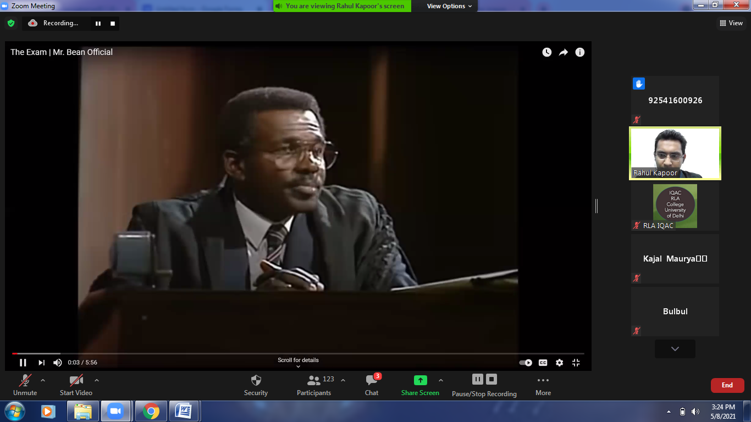
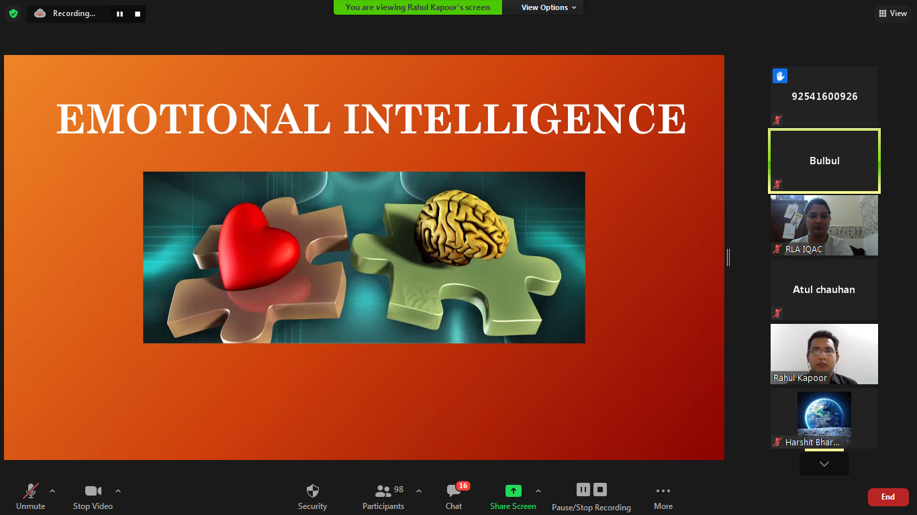
Glimpses of Workshop – Mr Rahul Kapoor

Slide 28
Workshop – Mr Brajesh Sharma
Mr. Brajesh Sharma, a Naturopathy Proponent, Consultant of Aeran Labs and a Life Member of Indian Red Cross, took a session on the topic of ‘Healthy Lungs for Life’ on 12th, 13th, and 14th of May, 2021.
321 with 192 females had participated in these sessions.
Mr Sharma did many activities and shown many ways to increase the lung capacity.
He also told about food which helps in keeping lungs healthy.

Slide 29
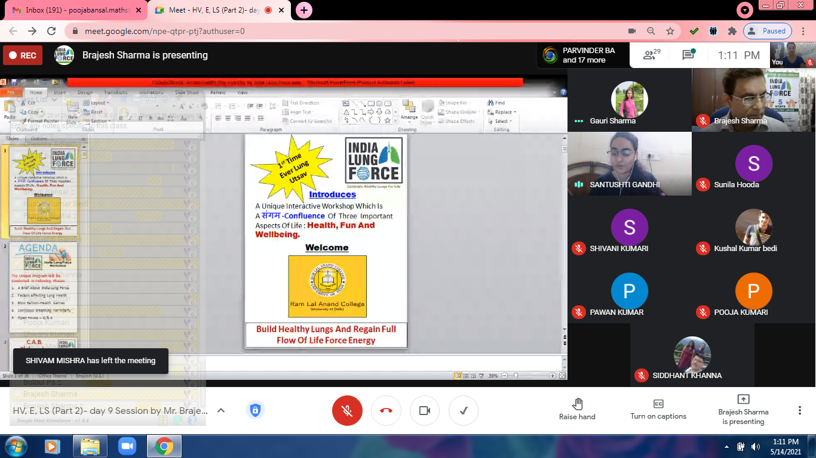
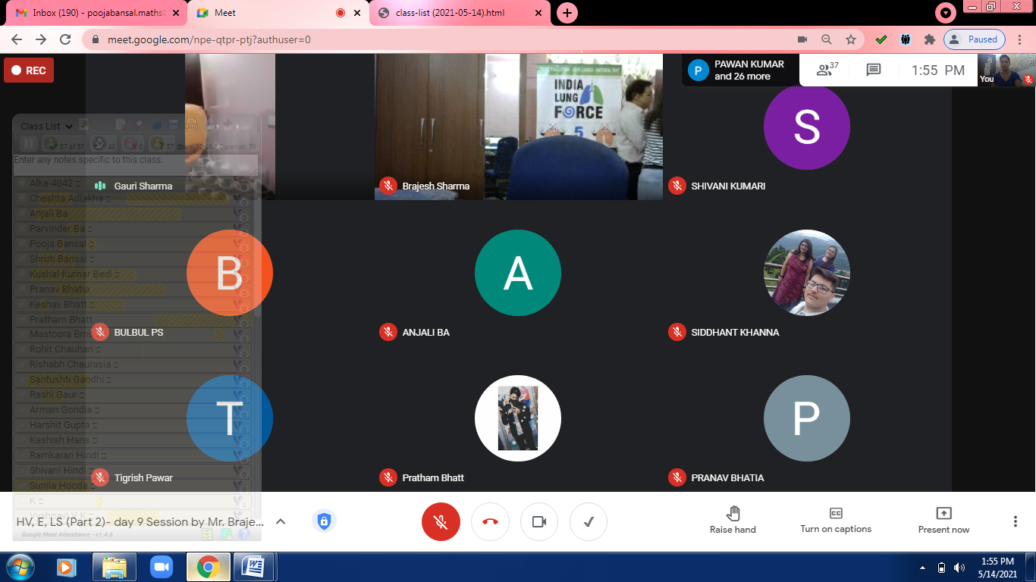
Glimpses of Workshop – Mr Brajesh Sharma

Slide 30
Workshop – Mrs Rita P Taneja
‘Choices and Decisions’ plays a crucial role in one's life because they determine one's fate and future, and so these two aspects of one's personality must be strong enough.
Our decisions and choices make us who we are, hence being decisive is an important life skill.
One must make a choice but at the same time one must be aware of the possible consequences of one’s choice. Thus it is important to weigh the consequences before making a decision and critical thinking provides a framework for working through these choices and decisions.
The session very interactive and over 281 (121) students attended it.

Slide 31
Glimpse of Workshop- Mrs Rita P Taneja

Slide 32
Glimpse of Workshop- Mrs Rita P Taneja

Slide 33
Workshop – Ms Anmol Kohli
Ms Anmol Kohli, a public speaker and educator.
Session was very interactive. Students discussed and participated with full enthusiasm.
She talked about various laws that protects women at work place, Institutions like college. She also made aware of women’ rights in details.
Participation was huge and over 336 with140 female students have attended the session.

Slide 34
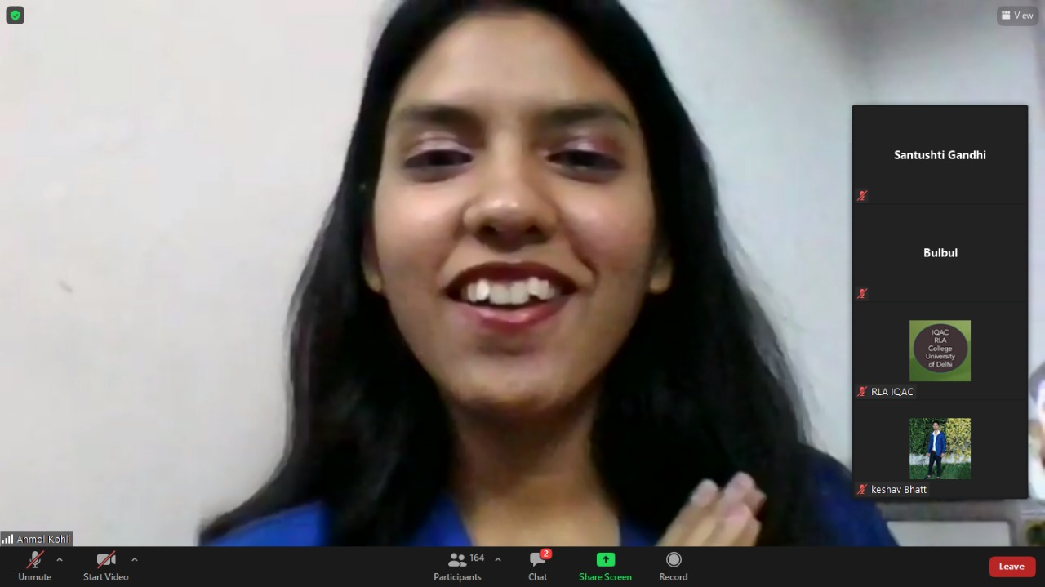
SOME HIGHLIGHTS FROM THE SESSION ITSELF

Slide 35
Workshop – Ms Pragatti Rao
‘Harmony in Society’ delivered by Ms Pragatti Rao on 16th, 17th, and 18th June, 2021.
She is a Principal consultant and Founder Director at EduConcepts India Initiatives and also a psychologist, personal growth and transformation Master Coach.
An individual is the nucleus of the society who if enriched with values, is an asset to the society.
Therefore one must develop values and should inculcate positive attitude.
One must practice patience and trust when interacting with other individuals, give them a chance to put their opinions and thoughts across.
Session was attended by 373 (135) students.

Slide 36
Glimpse of Workshop- Mrs Pragatti Rao

Slide 37
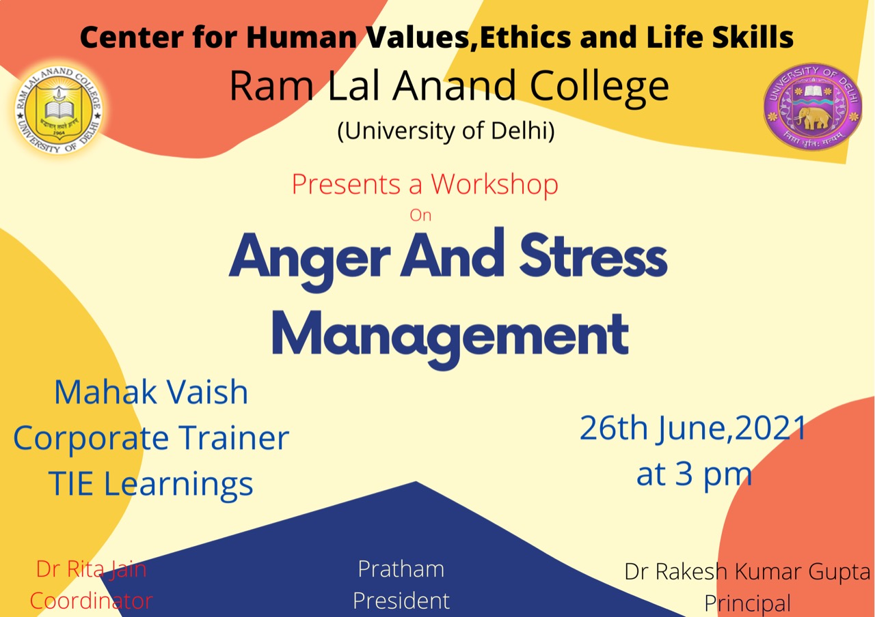
Workshop – Ms Mahak Vaish
Ms Mahak Vaish from TIE learning did the workshop on Stress and anger Management on 26th June,2021.
It was very engaging session. She gave many useful tips to calm ourselves during stress and anxiety.
She talked about how to balance ourselves in adverse circumstances.
Empowerment triangle may guide us to work on constructive way.
Gratitude and humanity are two ingredients for good mental health.
Session was attended by 197 (94) students.

Slide 38
Glimpse of Workshop- Ms Mahak vaish

Slide 39
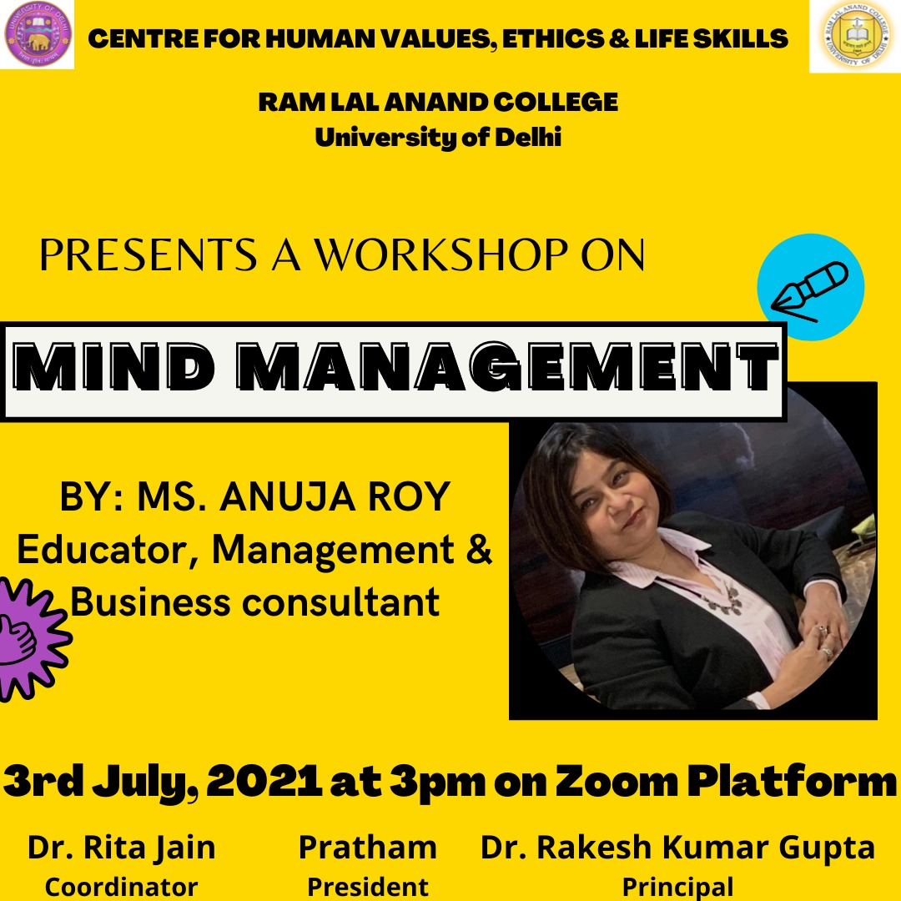
Workshop – Ms Anuja Roy
Educator and Business Consultant Ms Anuja Roy took session on Mind management on 3rd July, 2021.
She explained in detail about ways we can remain positive and ask students to identify their values for which they are passionate.
Auditing their time is another tip she gave to students.
She also discussed mind management techniques.
Her session was quite interactive with students.
174(81) students participated in the session.

